Slide 1
Evidence of LGBTQ Paraphernalia
at
Brunswick High School

Slide 2
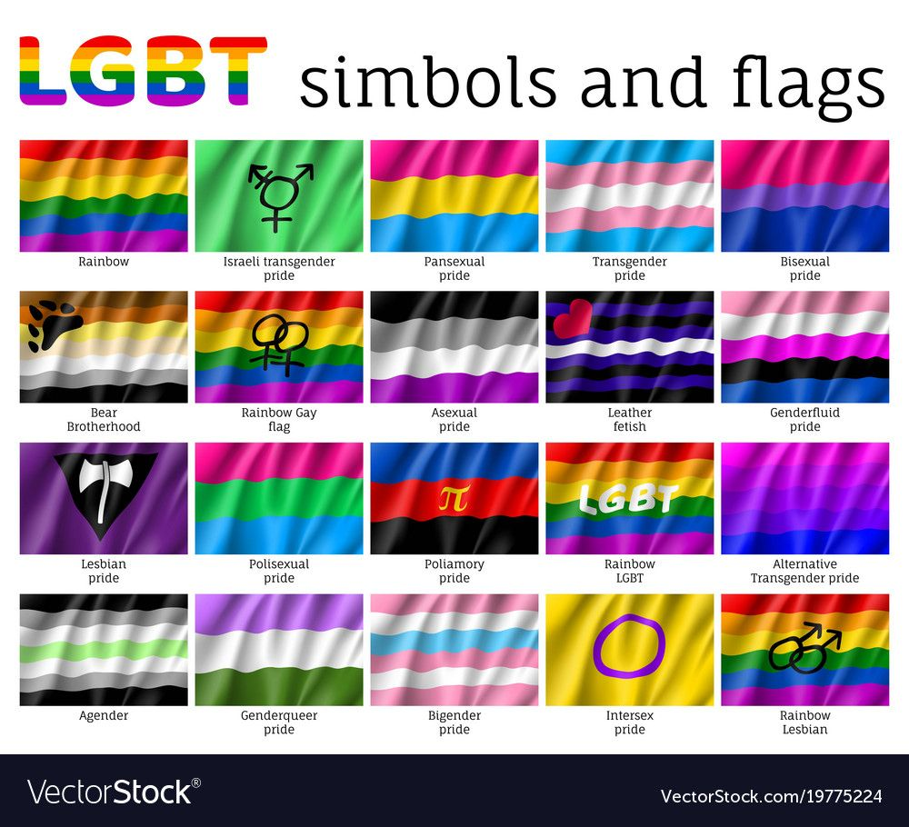
https://www.uwlax.edu/pride-center/lgbtq-101/lgbtq-flag-directory/

Slide 3
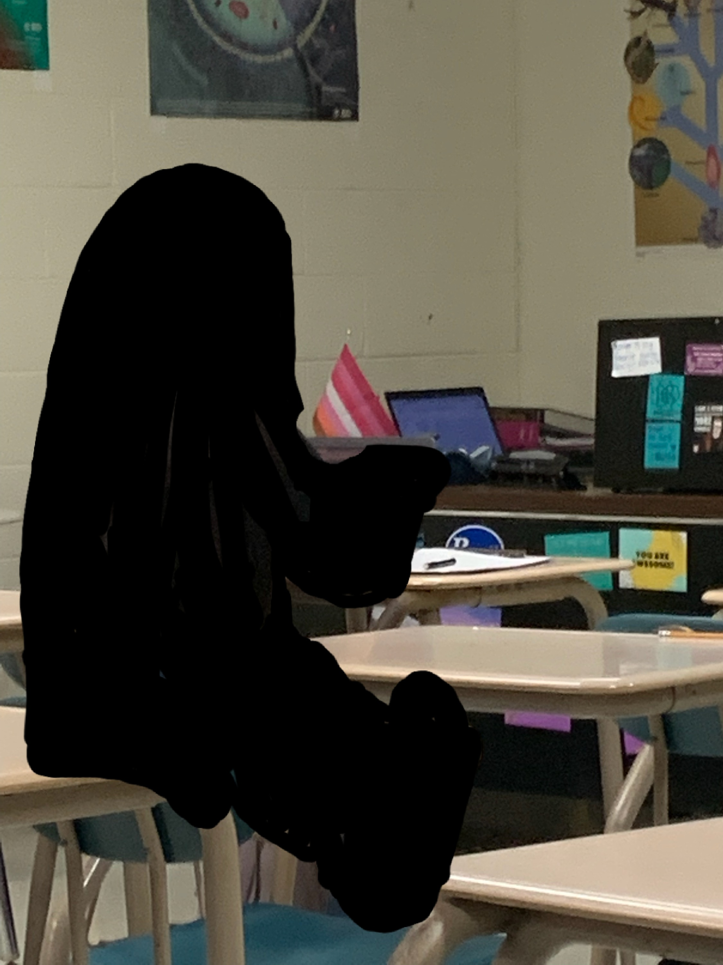
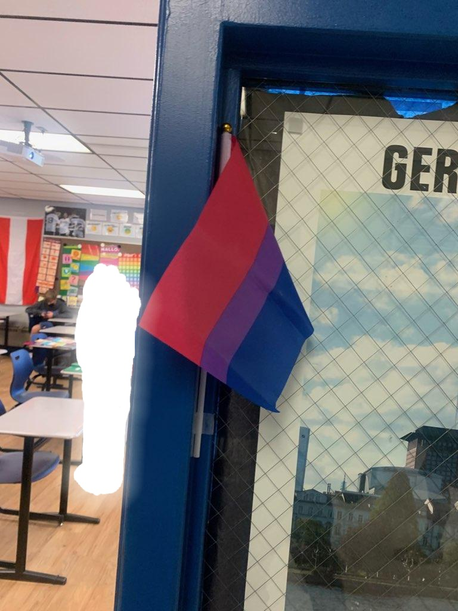
Lesbian Pride Flag in
BHS Classroom
Bisexual Pride Flag
in BHS Classroom

Slide 4
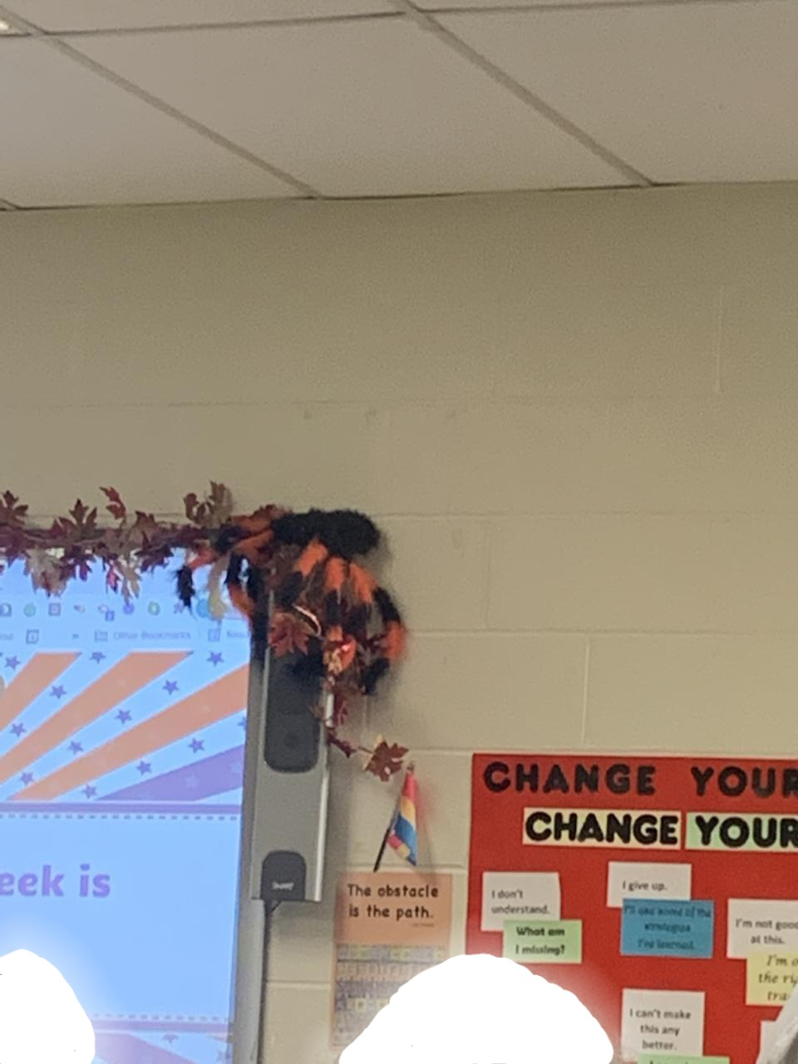
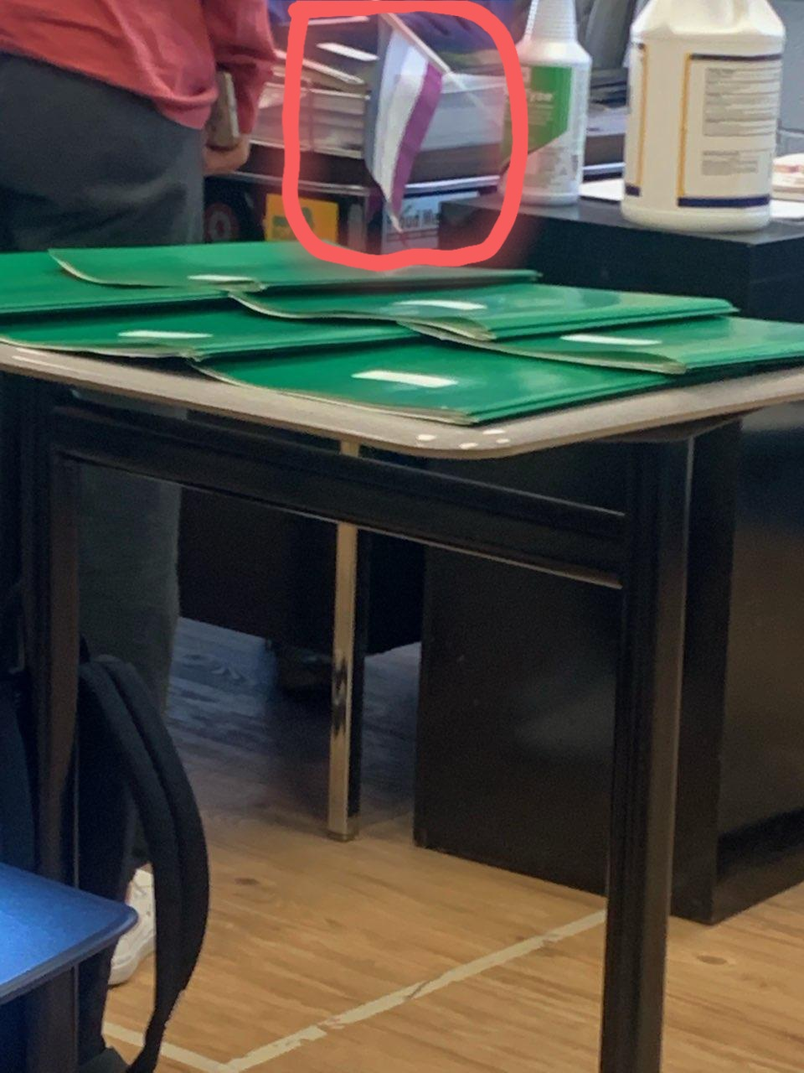

Pansexual Pride Flag
In BHS Classroom
Asexual Pride Flag

Slide 5
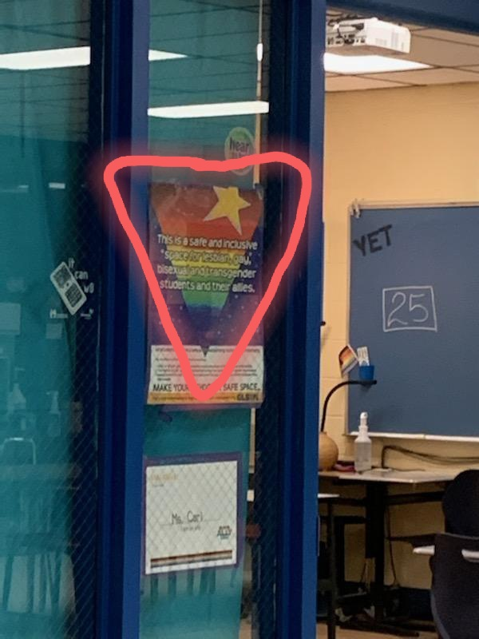
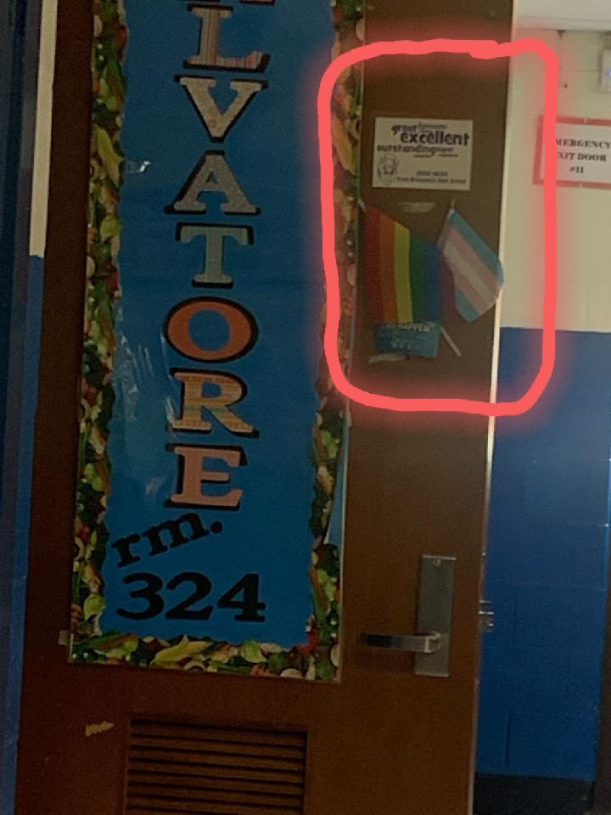
LGBTQ Triangle Flag
Classroom Door Ms. Carl
Classroom Door Ms. Salvatore
LGBTQ Flag and Transgender Pride Flag

Slide 6
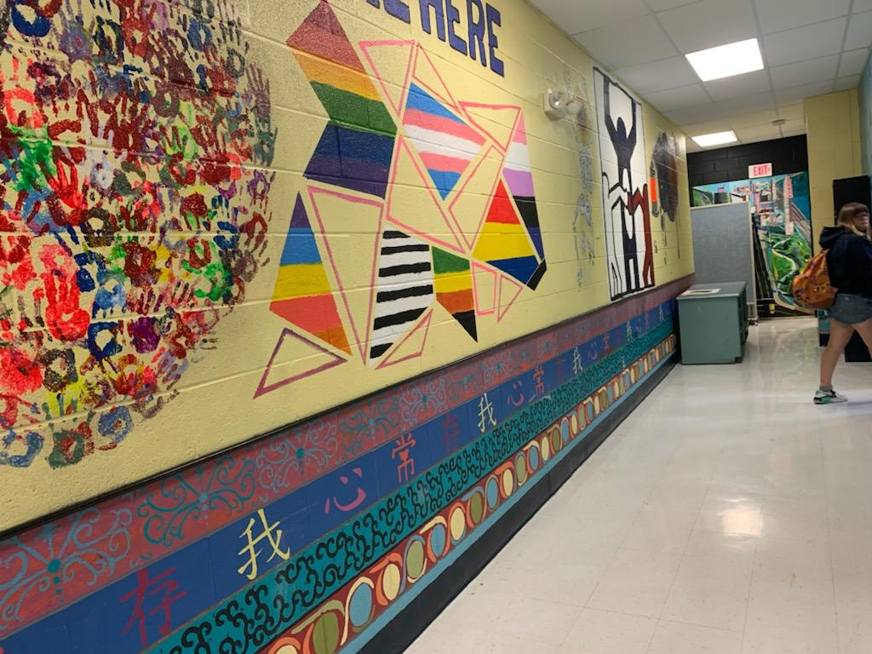
Mural on Wall in BHS Hallway

Slide 7
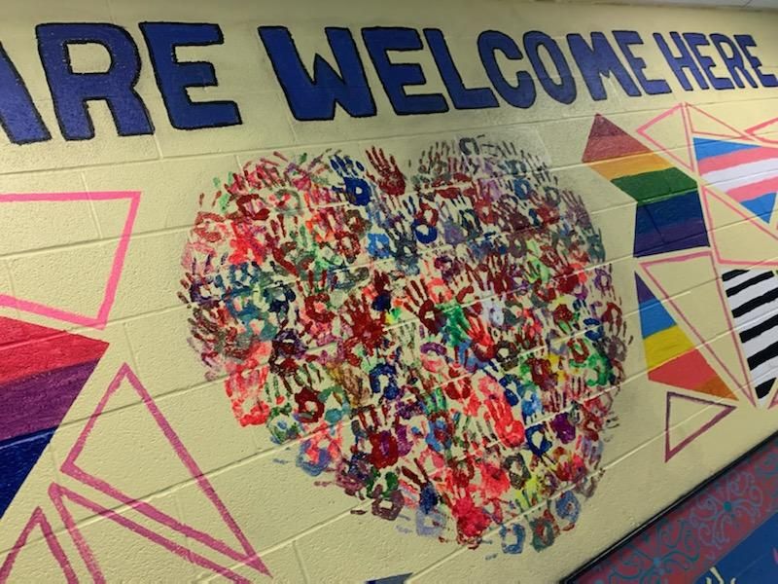
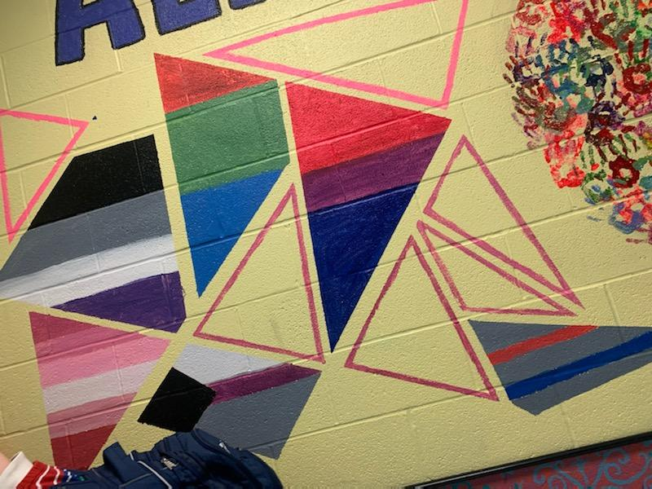
LGBTQ Flag Motifs from Mural at BHS

