Slide 1


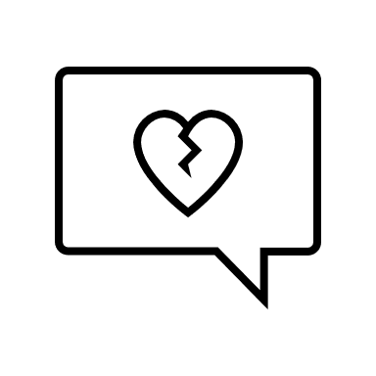
Dating Violence & Healthy Relationships
Cara Staresinic- Prevention Coordinator
caras@loraincountysafeharbor.org

Slide 2
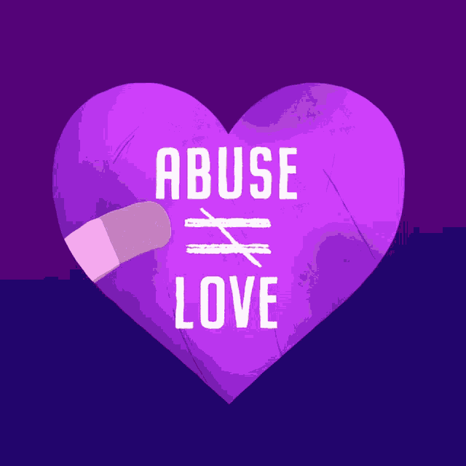
Topics Covered
What is Teen Dating Violence?
The Relationship Spectrum
Red Flags of Abuse
Types of Abuse
Cycle of Violence
Safety Planning for Teens
Green Flags of Dating
Resources
Notes:
What words come to mind when you think of domestic violence or dating abuse?

Slide 3


What is Teen Dating Violence?
(TDV)
Domestic violence is a pattern of abusive and coercive behaviors, including physical, sexual, and psychological attacks, as well as economic coercion, that adults and teens use against their partners. This is also referred to as intimate partner violence.
Abusive behaviors are used by the offender to establish and maintain power and control over their intimate partner or family member.

Slide 4

Why Talk About TDV?
Teenagers and young adults are at the highest risk for unhealthy relationships
Going through dating violence can affect your mood, mental health, self-esteem, and future relationships
Without help/support, unhealthy relationships can lead to a cycle of dating violence
It’s important to know what a healthy relationship looks like!
***You deserve a relationship where you feel respected, valued, and heard. Healthy relationships are about supporting each other, being honest, and feeling safe to be yourself. Never settle for less than the love and kindness you deserve***
Notes:
Teenagers and young adults are at the highest risk for unhealthy relationships.
This means many people your age experience things like controlling, mean, or hurtful behavior from a boyfriend or girlfriend, even if they don't realize it's wrong.
Going through dating violence can affect your mood, mental health, and future relationships.
Experiencing abuse in a relationship can leave you feeling anxious, depressed, or even unsure about what love should feel like later in life.
Without help, unhealthy relationships can lead to a cycle of bad relationships as adults.
If dating violence isn’t stopped, it can be easy to get stuck in a pattern of harmful relationships, even when you get older.
It’s important to know what a healthy relationship looks like.
Healthy relationships are built on things like trust, respect, and equality, where both people feel safe to be themselves and talk openly.

Slide 5
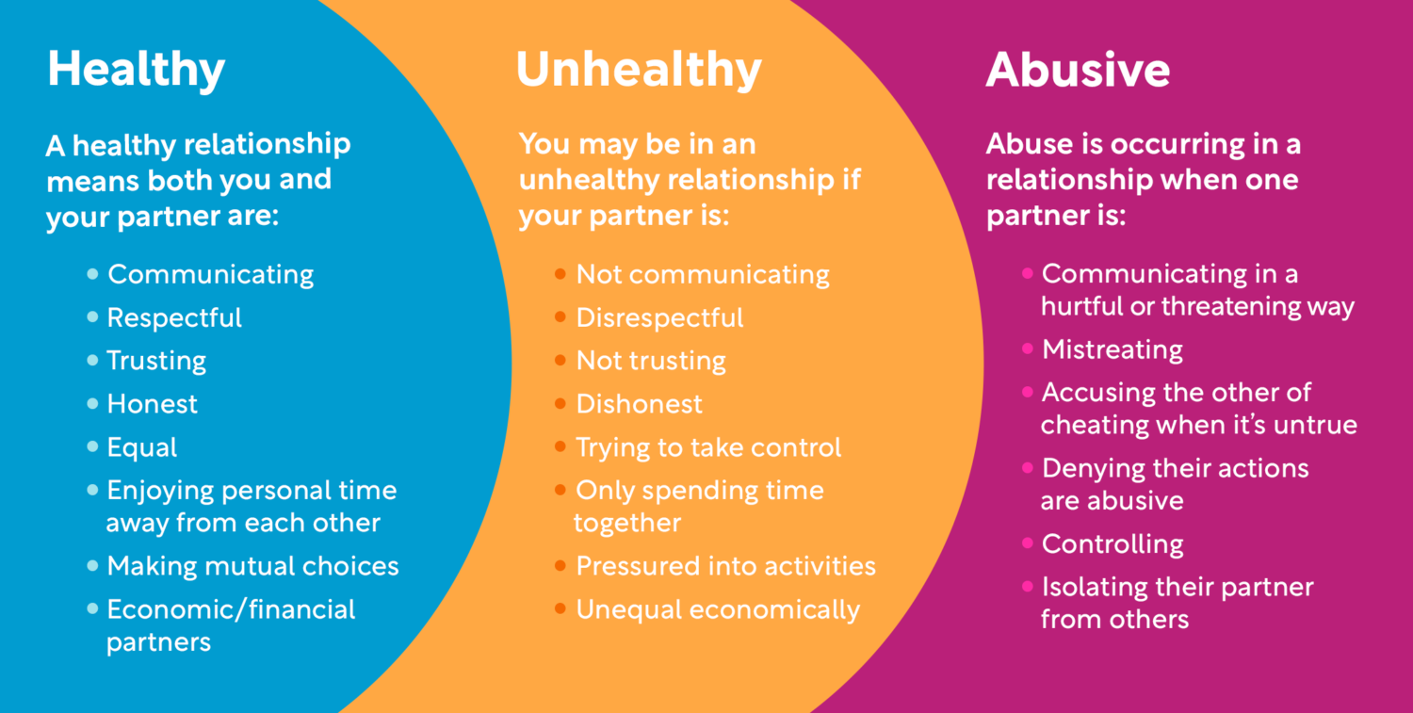
The Relationship Spectrum
Image: loveisrespect.org

Slide 6


How Does a Relationship go From Healthy to Unhealthy to Abusive?

Slide 7

Red Flags of Abuse
Isolation
Controlling Behavior
Jealousy
Blames Others for Problems/Feelings
Monitoring and Surveillance
Love Bombing

Slide 8

Red Flags of Abuse
Use of Force During a Fight
Gaslighting
History of Abuse
Verbal Abuse
Fear
Rigid Gender Roles

Slide 9

Red Flags of Abuse
Threats and Intimidation
Extreme Mood Swings
Not Respecting Boundaries

Slide 10
Types of Abuse
Emotional
Verbal
Physical
Sexual
Digital
Financial
POWER
&
CONTROL

Slide 11
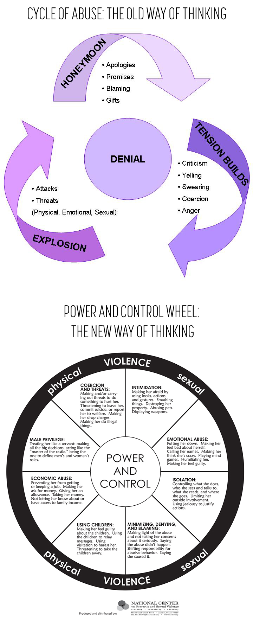
Understanding The Cycle of Violence

Slide 12

Safety Planning for Teens in a Violent Relationship
A safety plan is a simple, personal guide to help you stay safe if you are in an unhealthy or abusive relationship. It’s all about knowing what to do and who to go to when you feel unsafe, so you can protect yourself quickly and easily.
Steps of a Safety Plan
Identify trusted friends and supports
Plan for communication
Identify safe places to go
Set boundaries
Trust your instincts
Make an exit strategy
Document and report instances of abuse

Slide 13


Safety Planning for Teens
Other Things to Think About:
Emergency contacts and helplines
Create code words with friends
Transportation and money
Plan your exits
Breakup safely
Digital safety
Safety at school
Safety at home
Emotional safety

Slide 14


Safe Dating Habits and
Green Flags
Be assertive
Trust & respect both ways
Thoughts can be expressed openly
Things aren’t rushed
Mutual consent
Trust your instincts
Use social media cautiously
Have & respect boundaries
Equality
Space & privacy are your RIGHT
Honesty & open communication
Support personal growth
Discuss disagreements peacefully

Slide 15
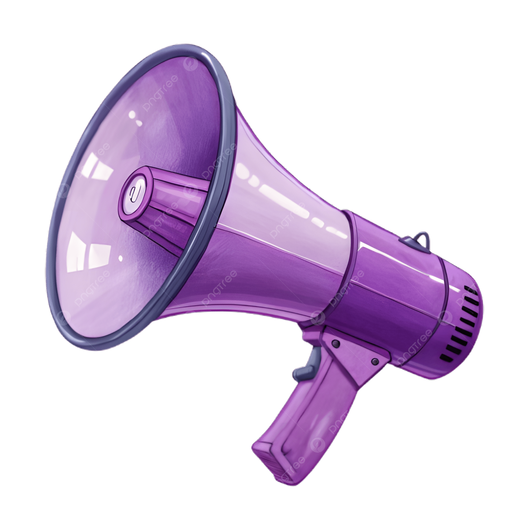
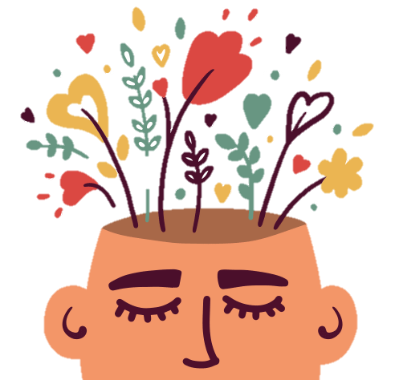
Your Words Matter!
Be mindful of…
Using gender stereotypes
Normalizing violence
Blaming victims
Social media influence
Words that hide abuse
Talking about healthy relationships
Empowering, Not Shaming!
Notes:
Gender Stereotypes: Saying things like "boys will be boys" or "girls are too emotional" can make it seem okay for people to act in hurtful ways.
Normalizing Violence: Jokes about hitting or controlling someone in a relationship make these actions seem less serious when they are actually harmful.
Blaming Victims: Asking "Why didn’t they leave?" blames the person who was hurt instead of focusing on the person who did the hurting.
Words That Hide Abuse: Calling someone “jealous” or “crazy” can hide serious problems like control or emotional abuse.
Social Media Influence: Seeing posts about “relationship goals” that show unrealistic or unhealthy behavior can give people the wrong idea of what a good relationship looks like.
Talking About Healthy Relationships: It’s important to use words that promote respect, boundaries, and communication, and to speak up when we see unhealthy behavior.
Empowering, Not Shaming: Using positive words about respect and kindness helps us understand we deserve healthy relationships, not ones that make us feel bad.

Slide 16
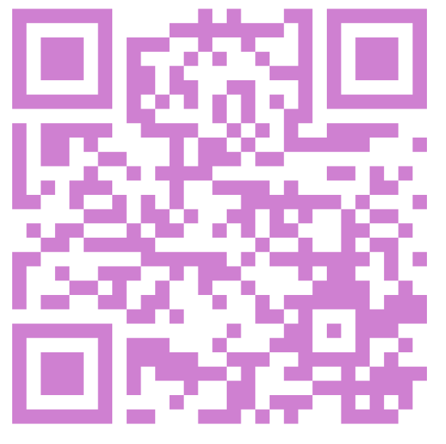
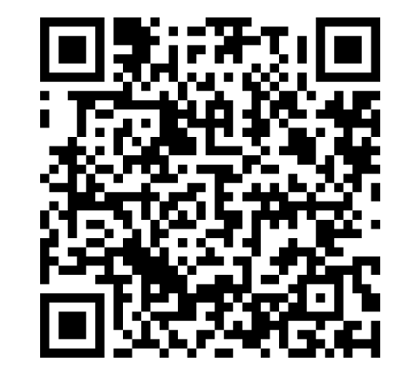
Resources
Local Resources:
Lorain County Safe Harbor – Domestic Violence
genesishouseshelter.org
(440) 244-1853 x1
Family Planning – Sexual Health
www.familyplanningservices.org
(440) 322-7526
Riveon Mental Health & Recovery – Rape Crisis and Sexual Assault Services
(440) 233-7232
988 for Suicide & Crisis Lifeline
Digital Resources:
Love is Respect – Teen Dating Violence
https://www.loveisrespect.org/
Text LOVEIS to 22522
RAINN – National Sexual Assault Hotline
https://rainn.org/
800-656-HOPE (4673)
The Hotline – DV & Interactive Safety Plan
https://www.thehotline.org/
1-800-799-SAFE (7233)
Text START to 88788
Notes:
What comes to mind now when you think of a healthy relationship?

Slide 17
Thank you
Cara Staresinic
caras@loraincountysafeharbor.org
440-244-1853 Ext. 9 Option2
www.genesishouseshelter.org

